Slide 1

Bangladesh Army University of Science and Technology (BAUST)
Saidpur Cantonment, Nilphamari
Department of Computer Science and Engineering (CSE)
Course Code: CSE 4140
Course Title: Machine Learning Sessional
Project Title: Spam Email Detection Using Machine Learning
Date: 25/11/2025
Presented By: Supervised By:
Nusrat Jahan (220201025) Engr. Rohul Amin
lecturer
Maisha Tasfia Hasan(220201039) Nadim Reza
Lecturer

Slide 2

Outline
Introduction
Objectives of the project
Related Works
Methodology
Flowchart
Output
Conclusion
2 December 2025
Spam Email Detection
2

Slide 3

Introduction
Spam emails are a growing problem
Manual filtering is not feasible
Machine learning offers an efficient solution
Features of emails can be used for classification
Fig-1: Email filtering
2 December 2025
Spam Email Detection
3

Slide 4
Objectives
To preprocess the email dataset by cleaning text, removing stopwords, and converting words into numerical features (TF-IDF).
To train machine learning models (like Naive Bayes, Logistic Regression, SVM, etc.) on the processed email data.
To evaluate the performance of the models using accuracy, precision, recall, and confusion matrix to check which model works best.
To build a prediction system that can automatically classify new emails as Spam or Ham based on the trained model.
2 December 2025
Spam Email Detection
4

Slide 5
Related Works
Table1: Previous Works of Spam Email Detection.
No | Title of Research | Author & year | Method Used | Evaluation Parameters | Remarks
1 | Email Spam detection using Support Vector Machine and Latent Semantic Indexing | Renuka and Visalakshi (2014) | Support vector Machine (SVM) with Latent Semantic Indexing (LSI) | Precision, recall and accuracy | Reported better results in terms of precision.
2 | Spam Mail Detection using Naïve Bayes, KNN Algorithm and reverse DBSCAN algorithm. | Harisin ghane yet al. (2014) | Naïve Bayes, KNN algorithm And Reverse DBSCAN algorithm | Precision, specificity, sensitivity and accuracy | Reported high precision but of very slow performance, was able to detect image scan.
3 | Spam Email Classification using Term Frequency Inverse | Moham ad and Selamat (2015) | Term Frequency Inverse and Rough Set Theory | Accuracy, Classification | Performed well in terms of feature extraction.
2 December 2025
Spam Email Detection
5

Slide 6
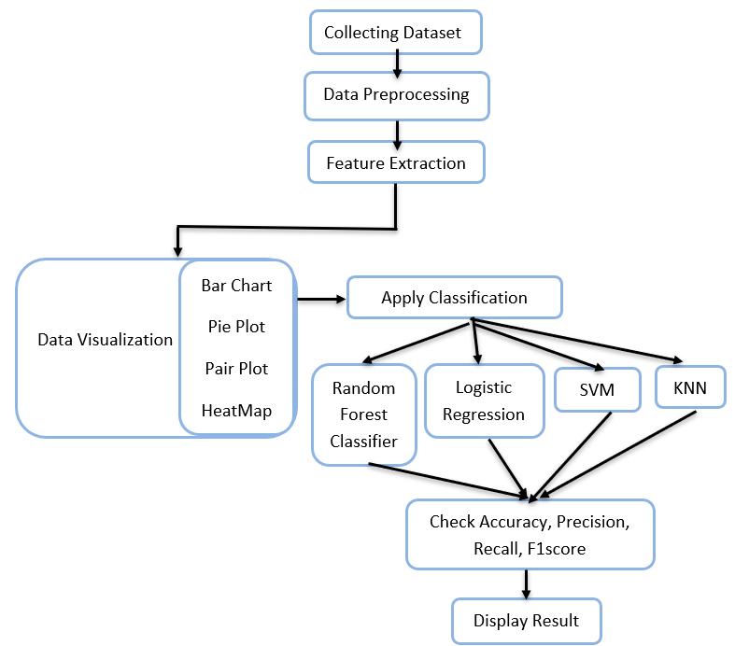
Methodology
Fig-2: Methodology of Spam Mail Detection.
2 December 2025
Spam Email Detection
6

Slide 7
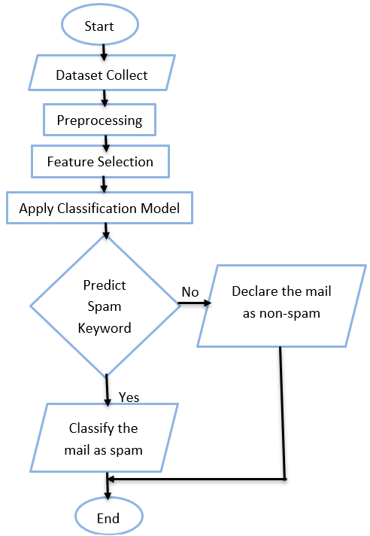
Flowchart
Fig-3: Flowchart of spam email detection.
2 December 2025
Spam Email Detection
7

Slide 8
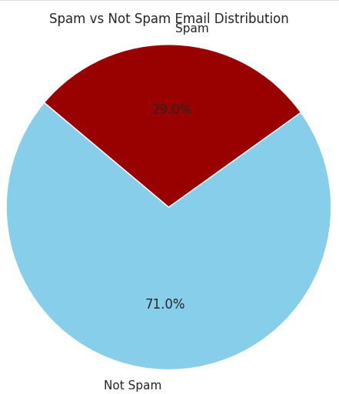
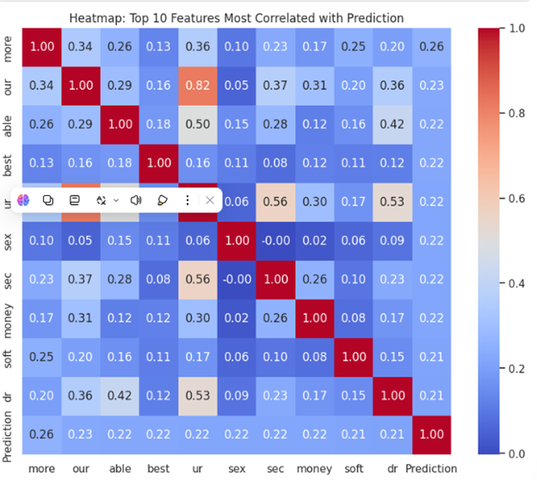
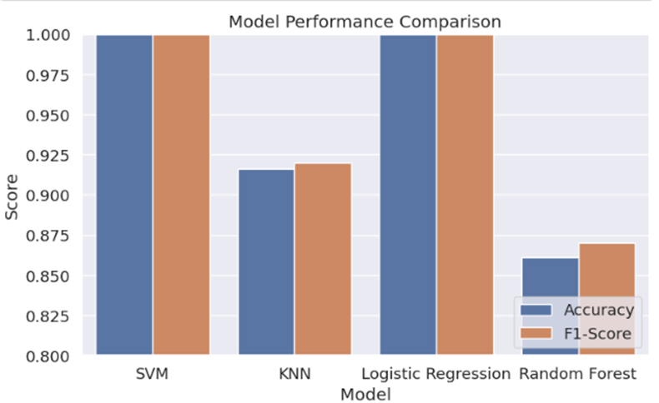
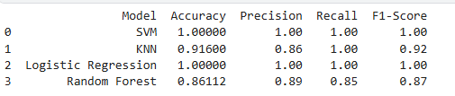
Output(visualization)
Fig-5: Pie chart.
Fig-4: Heatmap.
Fig-8: Model Performance Comparison.
Fig-7: Model Performance.
2 December 2025
Spam Email Detection
8

Slide 9
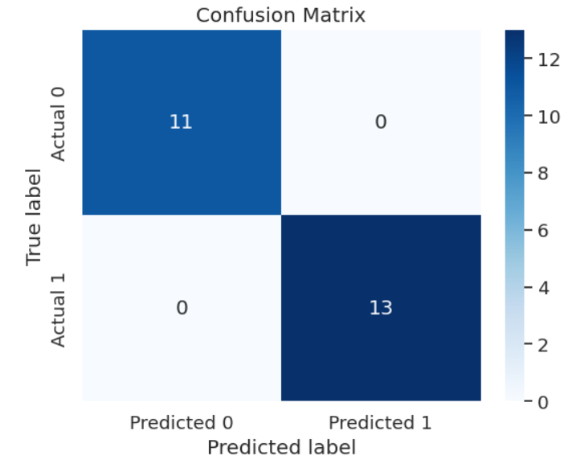
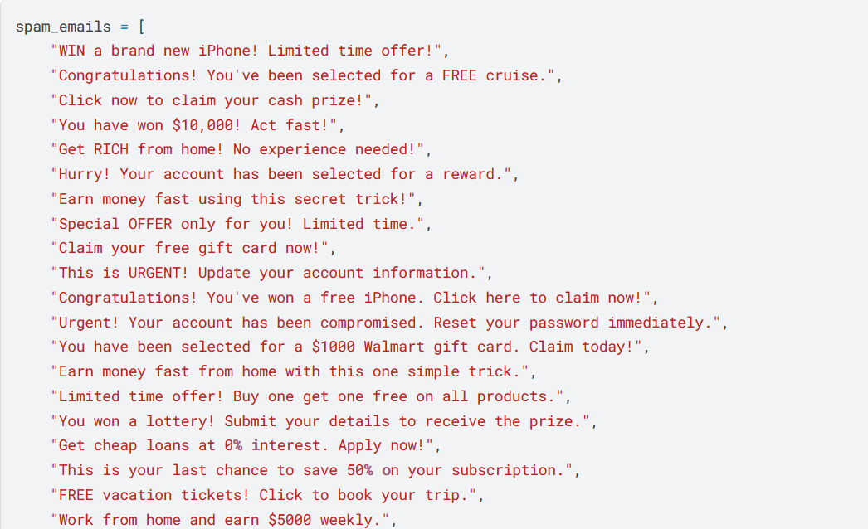
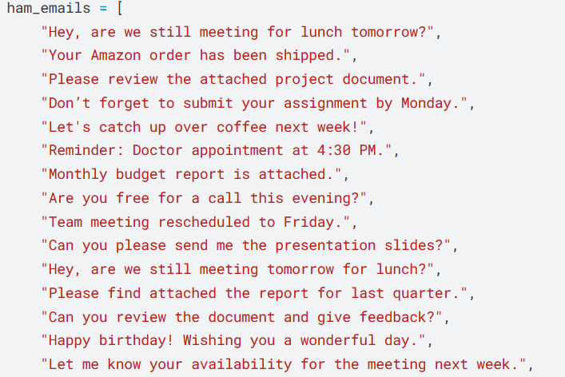
The confusion matrix was created based on the spam and ham emails shown on the slide.
The spam list contains messages with promotional or fraudulent keywords (e.g., “Win a prize”, “Click now”, “Free offer”).
The ham list contains normal everyday messages (e.g., meeting reminders, deliveries, reports).
Using these two groups, the model classified the emails and generated the confusion matrix:
11 ham emails correctly predicted as ham
13 spam emails correctly predicted as spam
No wrong predictions (0 false positives, 0 false negatives)
So the confusion matrix shows perfect classification (100% accuracy) based on the provided spam and ham email examples.

Slide 10
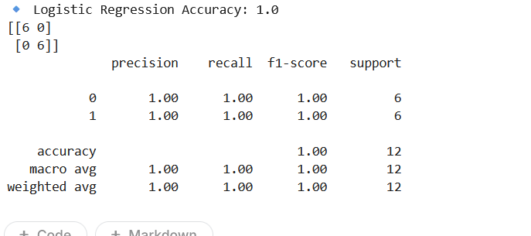
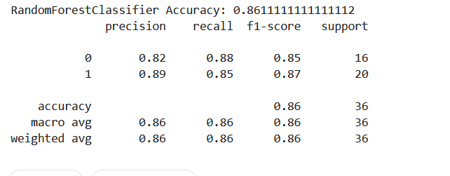
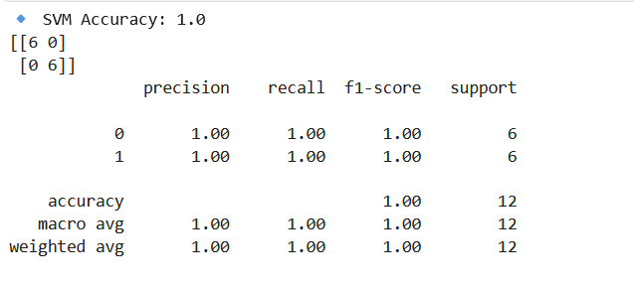
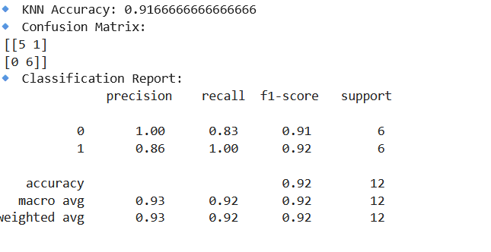
Model Accuracy
.
2 December 2025
Spam Email Detection
10

Slide 11
Conclusion
Spam email detection is essential for securing communication
Machine learning models can accurately identify spam emails.
Proper feature selection and preprocessing improve results.
2 December 2025
Spam Email Detection
11

Slide 12

Thank You
2 December 2025
Spam Email Detection
12

